Slide 1


SRI KRISHNA INSTITUTE OF TECHNOLOGY
DEPARTMENT OF INFORMATION SCIENCE AND ENGINEERING
A
TECHNICAL SEMINAR PRESENTATION
ON
“Fabric-iot : A Blockchain-Based Access Control System in IoT”
PRESENTED BY
SHUBHASHINI PAL [1KT17IS019]
UNDER THE GUIDANCE OF
Mrs. SHRUTI B P
ASSISTANT PROFESSOR,
DEPT. OF ISE
Dept of ISE, SKIT 2020-21

Slide 2
OVERVIEW
Abstract
Introduction
Literature Survey
Objectives of Proposed System
Methodology
Result
Conclusion
Future Enhancement
References
Dept of ISE, SKIT 2020-21

Slide 3
Abstract
IoT devices have some special characteristics, such as mobility, limited performance, and distributed deployment, which makes it difﬁcult for traditional centralized access control methods to support access control in current large-scale IoT environment
To address these challenges, this paper proposes an access control system in IoT named fabric-iot, which is based on Hyperledger Fabric blockchain frame work and attributed based access control (ABAC).
The system contains three kinds of smart contracts, which are Device Contract (DC), Policy Contract (PC), and Access Contract (AC).
DC provides a method to store the URL of resource data produced by devices, and a method to query it.
PC provides functions to manage ABAC policies for admin users.
AC is the core program to implement an access control method for normal users
Combined with ABAC and blockchain technology, fabric-iot can provide decentralized, ﬁne-grained and dynamic access control management in IoT.
The results show that fabric-iot can maintain high throughput in largescale request environment and reach consensus efﬁciently in a distributed system to ensure data consistency.

Slide 4
Introduction
In modern era with the developments of Internet and computer hardware, more and more devices are connected with each other through wireless network, making the scale of Internet of Things(IoT) larger and larger.
IoT is a distributed network composed of a large number of sensors and gateways. IoT devices interact with the environment all the time, producing different types of data resources, such as image, audio, video, digital signal, etc.
The resources produced by IoT devices often contain privacy and sensitive data, so there will be serious consequences when they are obtained illegally. The access control technology is an important means to protect resources, which has been widely used in various systems and environments.
Traditional access control methods include discretionary access control (DAC), identity-based access control (IBAC), and mandatory access control (MAC), etc. But these methods are all centralized designs, which have the disadvantages of single-point failure, difficult to expand, low reliability and low throughput
IoT devices may belong to different organizations or users, and probably have mobility and limited performance, which make centralized access control difficult to meet the requirements of access control in IoT environment.

Slide 5
cont.…
Attributed based access control (ABAC) is a logical access control model, which controls the access between sub- jects and objects, according to the attributes of entries, operations and related environments.
ABAC firstly extracts the attributes of user (subject), resource (object), permission and environment respectively, then combines the relationship of these attributes flexibly, and finally transforms the management of permission into the management of attribute, providing a fine-grained and dynamic access management method.
Blockchain is another kind of emerging data management technology, it ensures the reliability of data through distributed storage, and the blocks are linked by hash algorithm as a chain to ensure the integrity of the data It synchronizes data between nodes through P2P network and consensus algorithm, ensuring data consistency.
Hyperledger Fabric is an open- source blockchain development platform, which not only has the characteristics of blockchain such as decentralized ledger, immutable, and group consensus, but also provides more efficient consensus mechanisms, higher throughputs, smart contracts, and support for multiple organizations and ledgers.
In this project, applying blockchain technology to IoT access control, design and implement an access control system named fabic-iot, which is based on Hyperledger Fabric and ABAC. By using distributed architecture, fabric-iot can trace records, provide dynamic access control management and solve the access control problem in IoT.

Slide 6
Literature Survey
References | Objectives | Algorithm | Concepts | Journal/Conference/Year | Demerits
IoT-Assisted ECG Monitoring Framework With Secure Data Transmission for Health Care Applications | Improve iot frame work in medical fields | SPECIAL SECTION ON DEEP LEARNING ALGORITHMS FOR INTERNET OF MEDICAL THINGS | IOT, Machine Learning, Deep learning. | IEEE May 4, 2020. Digital Object Identifier10.1109/ACCESS.2020.2988059 | No high Signal Strength Analysis (SSA)
IoT-RTP and IoT-RTCP: Adaptive Protocols for Multimedia Transmission over Internet of Things Environments | To improve Multi media transmission using RTCP and RTP protocol | IoT-RTP descriptive algorithm and IoT-RTCP descriptive algorithm | RTP and RTCP , IOT | IEEE September 19, 2017. Digital Object Identifier 10.1109/ACCESS.2017.2726902 | The drawback of this method is that it has strict requirements for transmitting the multimedia streams and also The main drawback of this model is its dependency on the peer-to- peer concept

Slide 7
cont.…
References | Objectives | Algorithm | Concepts | Journal/Conference/Year | Demerits
An Empirical Study on System Level Aspects of Internet of Things (IoT) | To improve system level aspects of iot | Semantic Extraction Algorithm (SEA) And Semantic Inference Algorithm(SIA), machine learning algorithms, and automation techniques. | AI , ML , IOT, IoT, pillars of IoT, emerging IoT applications, IoT application requirements, IoT architecture, IoT application layer protocols | IEEE October27,2020. Digital Object Identifier 10.1109/ACCESS.2020.3029847 | The instructions of the high priority tasks may not be executed in the given time
EMS: An Energy Management Scheme for Green IoT Environments | Methods to implement iot in farming subjects | 1 and algorithm 2 describe the scheduling models for the WSN and RFID nodes, and algorithm 3 describes how the proposed EMS works. | IoT Energy Management Scheme (EMS) | IEEE 27 February 2020 Digital Object Identifier 10.1109/ACCESS.2020.2976642 | Green iot environment
Smart Urban Living: Enabling Emotion-Guided Interaction With Next Generation Sensing Fabric | To bring updation in modern iot in every day life | data analysis algorithm, decision fusion algorithm, deep learning, genetic algorithm. | IoT, deep learning, AI, | IEEE 24 December 2019 Digital Object Identifier 10.1109/ACCESS.2019.2961957 | Urbun living architecture is complex

Slide 8
objective
  To define a device resource sharing model according to the data production of the IoT devices in real life. The model makes the data resources generated by the device correspond to the URL one by one, greatly simplifying the sharing mode and storage structure of the device resources.
  To propose a blockchain-based access control system for IoT named fabric-iot and describe its workflow and architecture in detail. The system uses distributed architecture to separate users and devices, and implemented the dynamic management of permissions to support efficient access.
  To design three kinds of smart contracts based on the Hyperledger Fabric platform. The first one implements the ABAC model. The second one implements the ABAC policy management. The last one implements the device resource management.
  To introduce the network initialization, chain code installation, and smart contract invoking of fabric-iot in detail.
  To design two groups of comparative experiments to verify the system performance and consensus speed

Slide 9
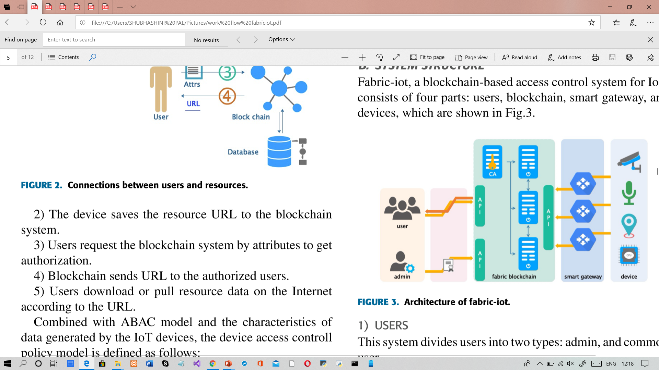
Methodology
Figure 1: Architecture Of Fabric IOT

Slide 10
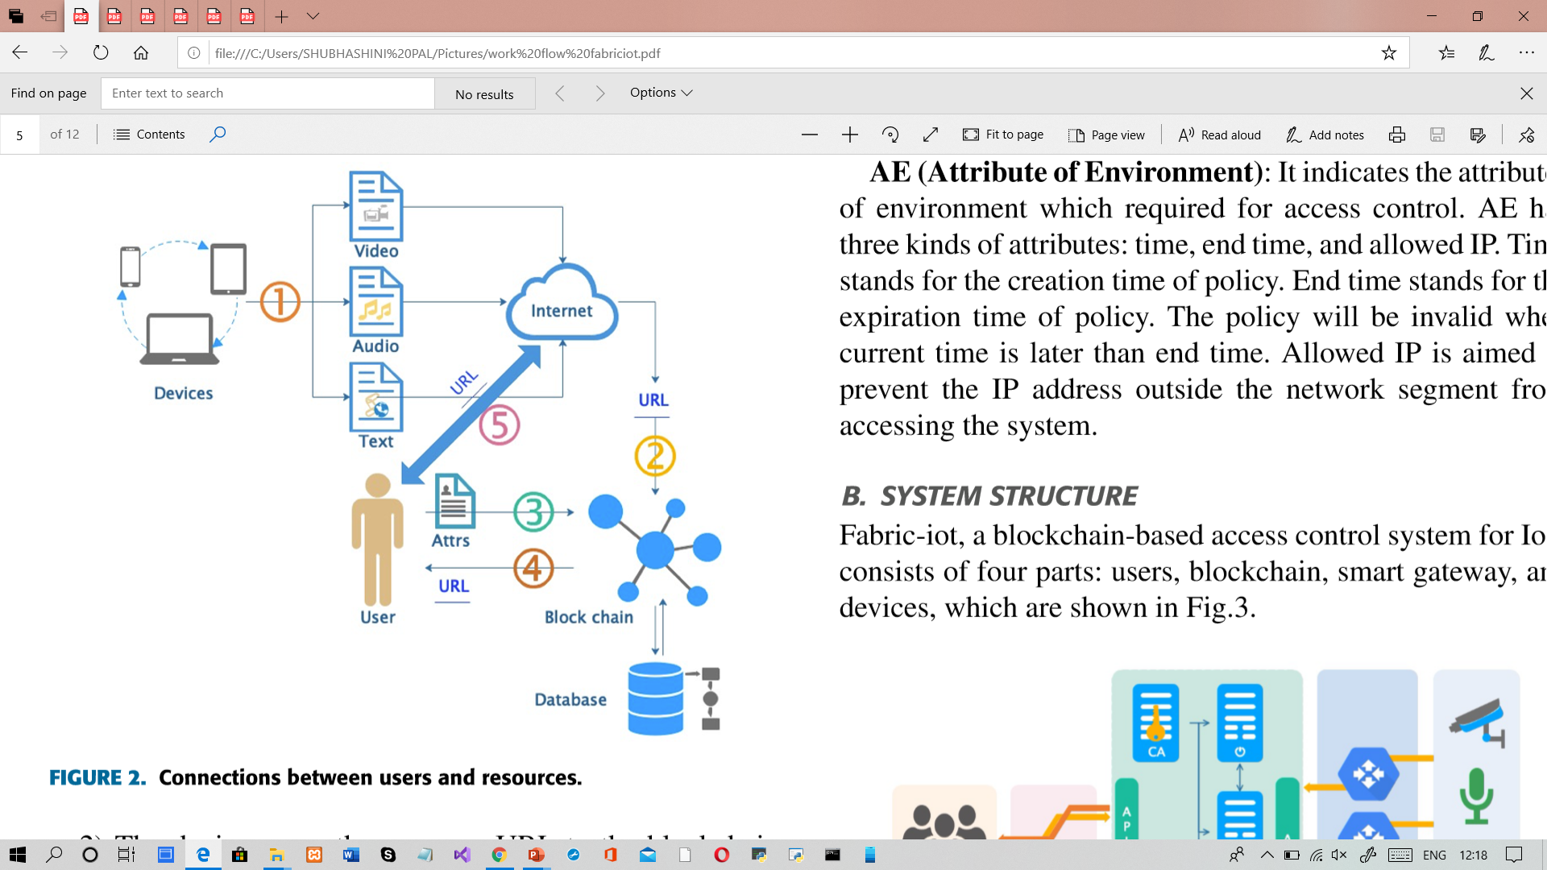
Cont.…
Figure 2: Connections between Users and Resources.

Slide 11
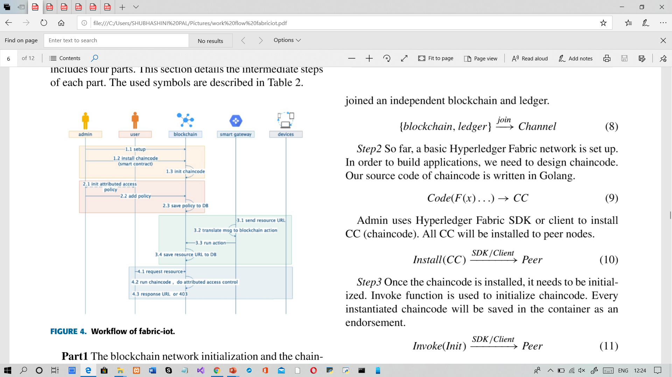
Cont.…
Figure 3:Workflow of Fabric-IOT.

Slide 12
result
In order to test the performance of fabric-iot system, two groups of comparative experiments were designed by simulating concurrent access to the system with multithreaded clients. In the ﬁrst group of experiments, they have count the processing time of PC, AC and DC with different numbers of concurrent requests. The numbers of virtual clients are set to 50, 100, 200, 500, 1000. The statistical results achieved.
And this experiments can prove that fabric-iot can maintain high throughput in large-scale request environment, and can effectively reach consensus in distributed system to ensure data consistency.

Slide 13
Conclusion
Firstly, according to the actual production data of the IoT devices, they proposes a device authority model.
Secondly, according to the ABAC model, they implements the ABAC policy management and ensures the access security of the device resources by implementing the smart contract application. Furthermore, an open-source access control system named fabric-iot based on Hyperledger Fabric is designed and implemented.
This system adopts distributed architecture, which can provide ﬁne-grained and dynamic access control management for the physical network.
Finally, the steps of blockchain network building, chain code installation, smart contract invoking are described in detail, and the experiments show a convincible results. Above all, this paper provides a practical reference for other researchers to carry out relevant research.

Slide 14
Future enhancement
Future works can be improved in the following aspects:
1)The experiments in this paper is carried out on two PCs. In the future, we consider using the cluster or the edge computing service to deploy, and further verify the distributed performance of this system.
2) In the future, more physical devices can be used to test the reliability and throughput of the system.
3) Future research can try to improve the scalability of fabric-iot and to support more IoT application integration

Slide 15
References
[1] K. Kostal, P. Helebrandt, M. Bellus, M. Ries, and I. Kotuliak, ‘‘Management and monitoring of iot devices using blockchain,’’ Sensors, vol. 19, no. 4, p. 856, Feb. 2019.
[2] J.Yang, S.He, Y.Xu, L.Chen, and J.Ren, ‘‘A trusted routing scheme using blockchain and reinforcement learning for wireless sensor networks,’’ Sensors, vol. 19, no. 4, p. 970, Feb. 2019
[3] S. Ding, J. Cao, C. Li, K. Fan, and H. Li, ‘‘A novel attribute-based access control scheme using blockchain for IoT,’’ IEEE Access, vol. 7, pp. 38431–38441, 2019.
[4] M. Cui, D. Han, and J. Wang, ‘‘An efﬁcient and safe road condition monitoring authentication scheme based on fog computing, ’’IEEE Internet Things J., vol. 6, no. 5, pp. 9076–9084, Oct. 2019.
[5] M. Ma, G. Shi, and F. Li, ‘‘Privacy-oriented blockchain-based distributed key management architecture for hierarchical access control in the IoT scenario,’’ IEEE Access, vol. 7, pp. 34045–34059, 2019.
[6] Z. Yang, K. Yang, L. Lei, K. Zheng, and V. C. M. Leung, ‘‘Block chain based decentralized trust management in vehicular networks,’’IEEEInternet Things J., vol. 6, no. 2, pp. 1495–1505, Apr. 2019
[7] O.Novo,‘‘Scalable access management in IoT using blockchain: A performance evaluation,’’ IEEE Internet Things J., vol. 6, no. 3, pp. 4694–4701, Jun. 2019
[8] H. Li and D. Han, ‘‘Edu RSS: A blockchain-based educational records secure storage and sharing scheme,’’ IEEE Access, vol. 7, pp. 179273–179289, 2019.

Slide 16
Thank you

